Slide 1
High speed networks project
Flow Optimization in Multipath Network using Maximum Flow Algorithm to Improve the Bandwidth Usage in SDN

Slide 2
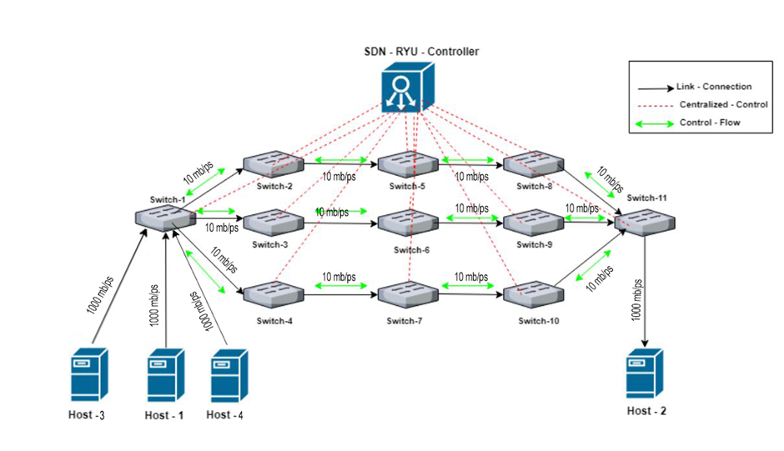
TOPOLOGY

Slide 3
GENERAL PURPOSE
Traditional network architecture is distributed and complicated compared to the Software Defined Networking (SDN).
Find the maximum flows by using augmented paths in the multipath network and forwarding the network traffic flow from source to the destination.
Using Dinic’s max flow algorithm is used to find the maximum flows and maximize the throughput with bandwidth constraints in the software defined network.

Slide 4
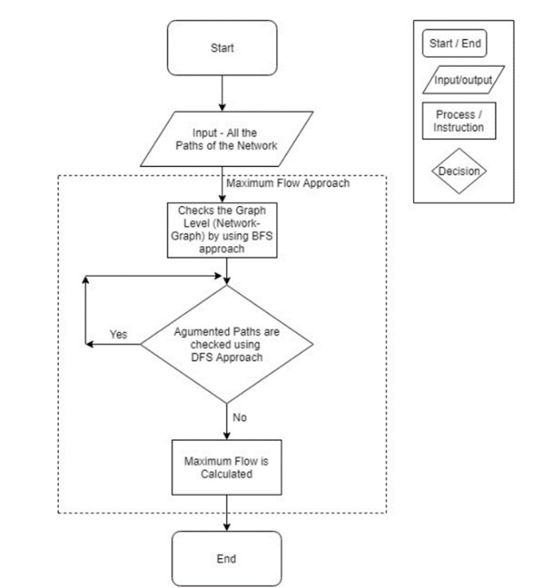
Main algorithm: Multi path MAX-FLOW
The Max Flow algorithm is used to determine the maximum amount of flow that can be sent through a network from a source node to a sink node. It works by iteratively finding augmenting paths from the source to the sink and incrementing the flow along these paths. The algorithm terminates when there are no more augmenting paths, yielding the maximum flow value.

Slide 5
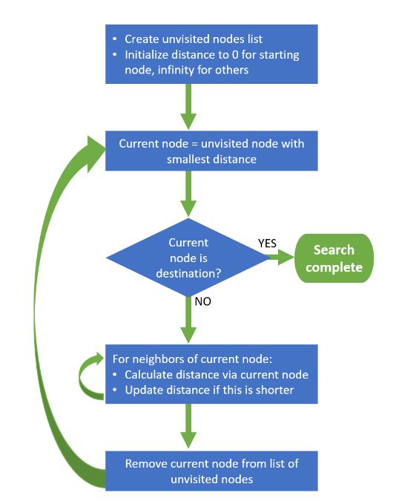
Comparison algorithm: Single path Dijkstra
Dijkstra's algorithm is a popular algorithm used to find the shortest path between nodes in a graph. It starts from a source node and iteratively selects the node with the lowest cost to reach and expands the search to its adjacent nodes. The algorithm maintains a priority queue to efficiently select the next node and updates the minimum cost to each node until the shortest path to the destination node is found.

Slide 6
The experiment
We used 3 hosts for the ability to divide the flows , so we could differentiate the flows from each hosts to find a different bucket for each flow.
We sent packets from each host {H1,H3,H4} to H2 using IPERF.
We calculated the average throughput, using the IPERF statistics written into a file.
We looked at the wireshark PCAPs to ensure that the paths were travelling as we wanted, in a multipath way for the max flow and for the Dijkstra that the same path was chosen.

Slide 7
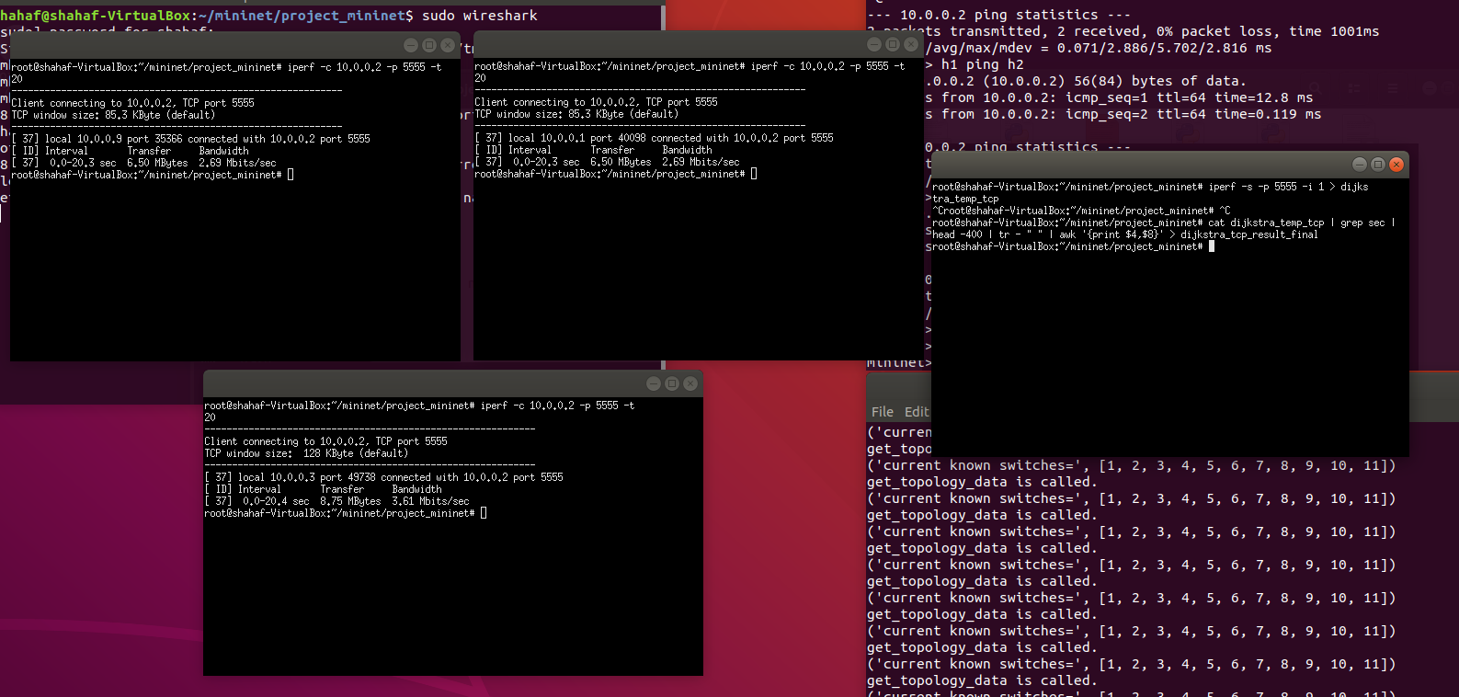
The experiment – tcp Dijkstra

Slide 8
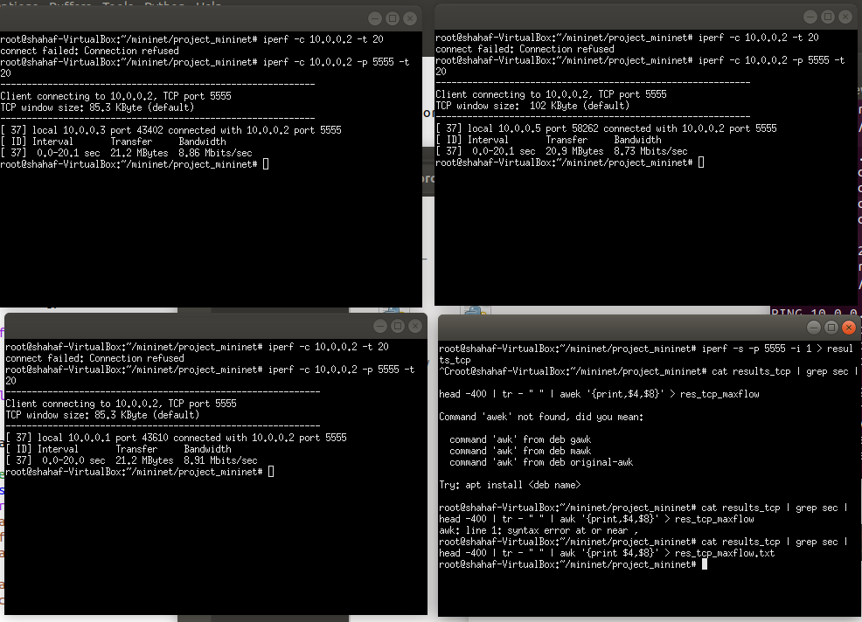
The experiment – tcp max flow

Slide 9
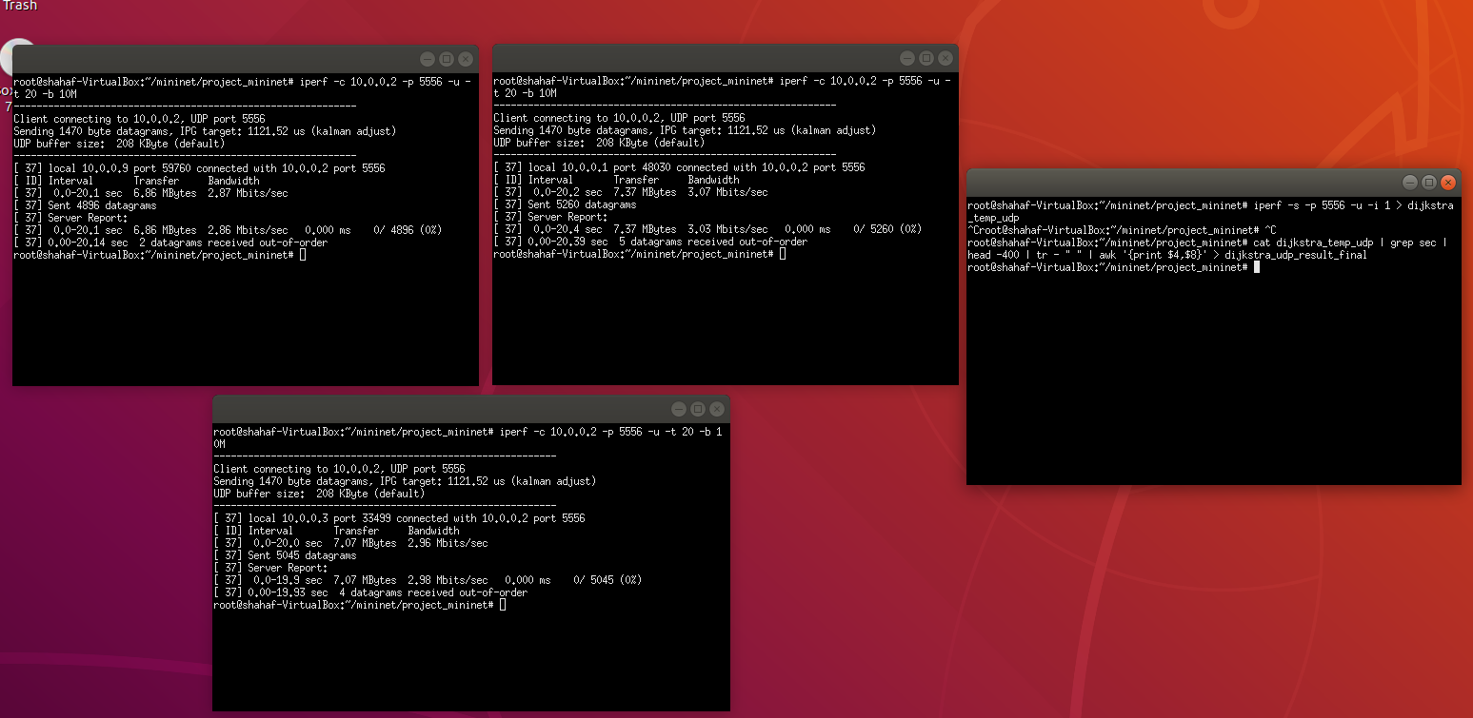
The experiment – udp Dijkstra

Slide 10
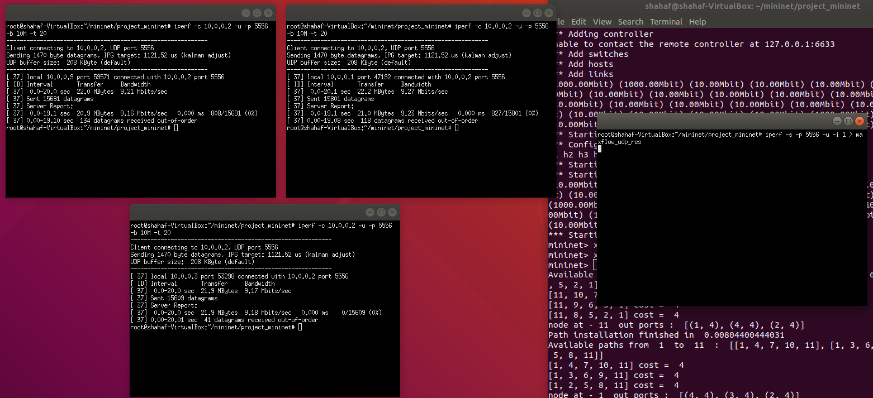
The experiment – udp

Slide 11

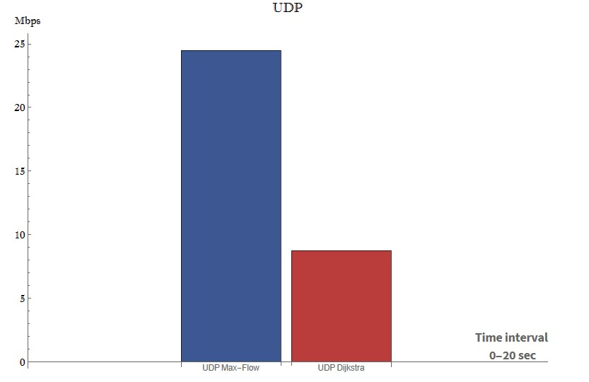
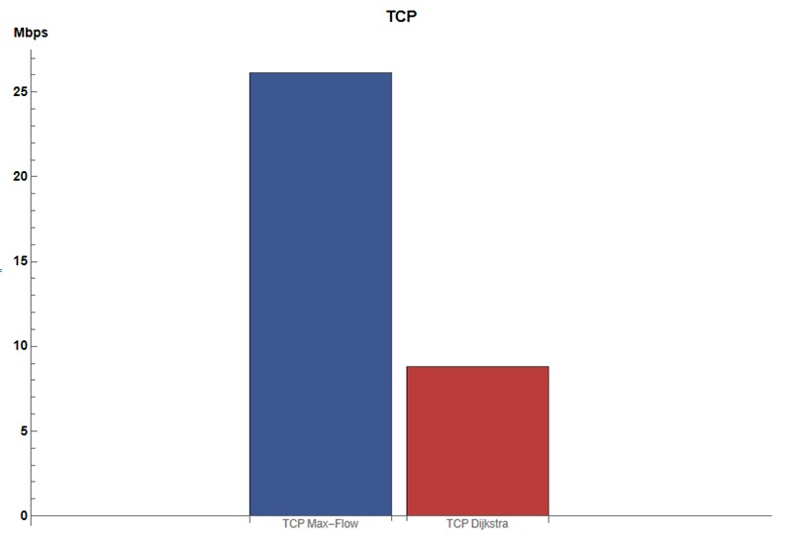
Results
In the pictures to the right we can see the average throughput for both the TCP and the UDP comparisons, with the Maxflow and the Dijsktra alrorithms.

Slide 12
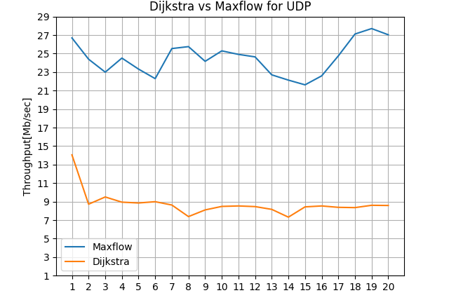
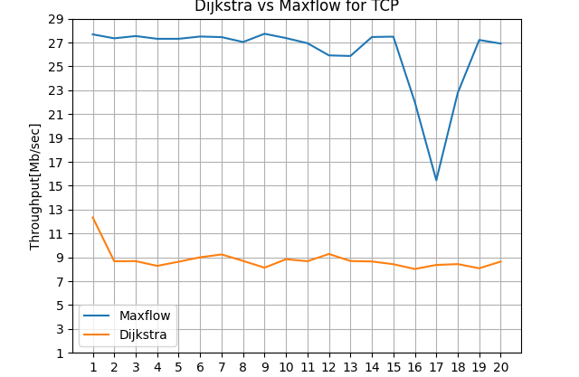
Results
On the right we can see comparisons between the Dijkstra and the Max flow throughputs at each second during our testing interval of 20 seconds.
As we can see, the max flow outperforms the Dijkstra significantly in this topology.

Slide 13
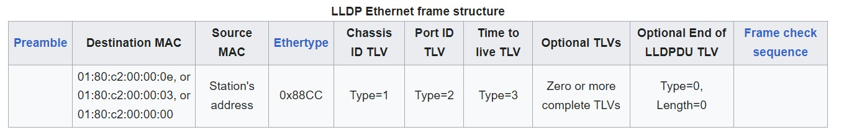
lldp
Preamble: 7-byte, helps detect start of the frame and synchronize their clocks with the incoming data.
Destination MAC: 6-byte, MAC address of the device to which the frame is being sent.
Source MAC: 6-byte, MAC address of the sender.
EtherType/Length: 2-byte, indicates either the type of payload encapsulated in the frame or the length of the frame. If number >= 0x0600: EtherType, type of the payload protocol. Else: indicates the length of the frame.
Chassis ID TLV: 66 bytes, identifies the chassis component of the endpoint identifier associated with the transmitting LLDP agent.
Port ID: 66 bytes, identifies the port component of the endpoint identifier associated with the transmitting LLDP agent.
Time to live: 66 bytes, maximum lifespan or remaining time that LLDP frame can be propagated through the network.
Frame check sequence: 4 bytes, cyclic redundancy check (CRC) value used for error detection.

Slide 14
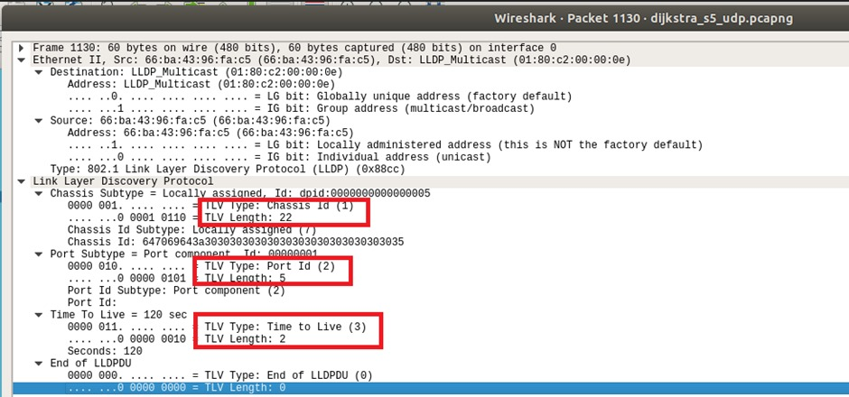
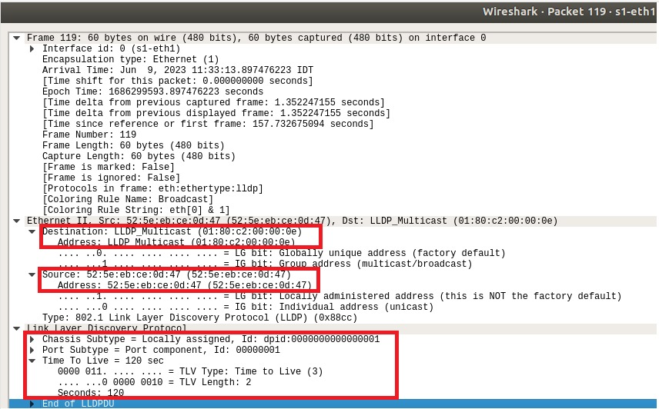

Slide 15
mdns
The main purpose: simple and efficient way to resolve hostnames to IP addresses in local network.
DNS is used to map domain names to IP addresses, but it requires a DNS server that maintains the mappings.
mDNS is decentralized and uses IP multicast to resolve hostnames.
device joins a network, sends out an mDNS query asking for the IP address associated with a specific hostname or service. sent to multicast address, allowing all devices on the network to receive it.
Devices that can fulfill the request respond with a mDNS response packet, providing the requested IP address and other relevant information. These responses sent by multicast ,so all devices can receive them.
The querying device receives the mDNS responses and can then establish communication with the device(s) offering the requested service.

